Slide 1
Intramolecular Bonds
(Bonds Between Atoms)
Ionic
Covalent
Polar
Nonpolar

Slide 2
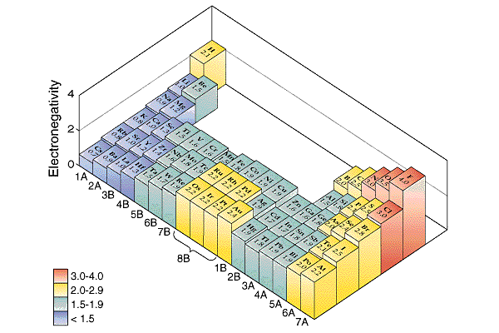
Bond Polarity and Electronegativity
Electronegativity: The ability of one atoms in a molecule to attract electrons to itself.
Pauling set electronegativities on a scale from 0.7 (Cs) to 4.0 (F).
Electronegativity increases
across a period and
up a group.

Slide 3
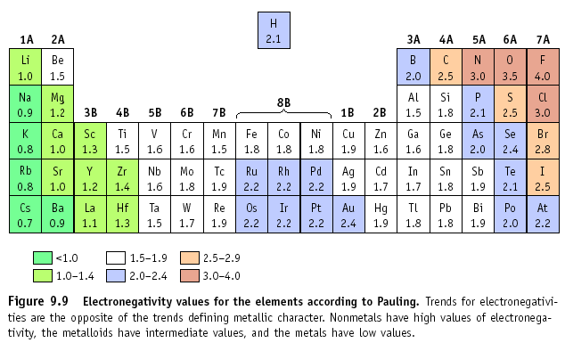
The type of bond can usually be calculated by finding the difference in electronegativity of the two atoms that are going together.

Slide 4
Electronegativity Difference
If the difference in electronegativities is between:
1.7 to 4.0: Ionic
0.41 to 1.7: Polar Covalent
0.0 to 0.4: Non-Polar Covalent
Example: NaCl
Na = 0.9, Cl = 3.0
Difference is 2.1, so
this is an ionic bond!

Slide 5
Is the sharing of electrons in molecules always equal?
non-polar bond
X
Y
ΔEN = 0
Which element is more electronegative?
X
Y
ΔEN = 0.4
X
Y
ΔEN = 0.6
increasing polarity of bond
EN_{Y} > EN_{X}
polar bond
X
Y
ΔEN = 0.9
0.4 < EN < 1.7
X
2+
Y
2-
ΔEN = 1.9
Direction of electron migration

Slide 6

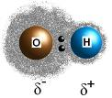
First, we are going to look at Polar Covalent…
What is polar covalent?
-Polar covalent is a description of a bond that has an uneven distribution of charge due to an unequal sharing of bonding electrons.
The boy is not equally sharing with anyone else but rather taking all the food for himself.

Slide 7
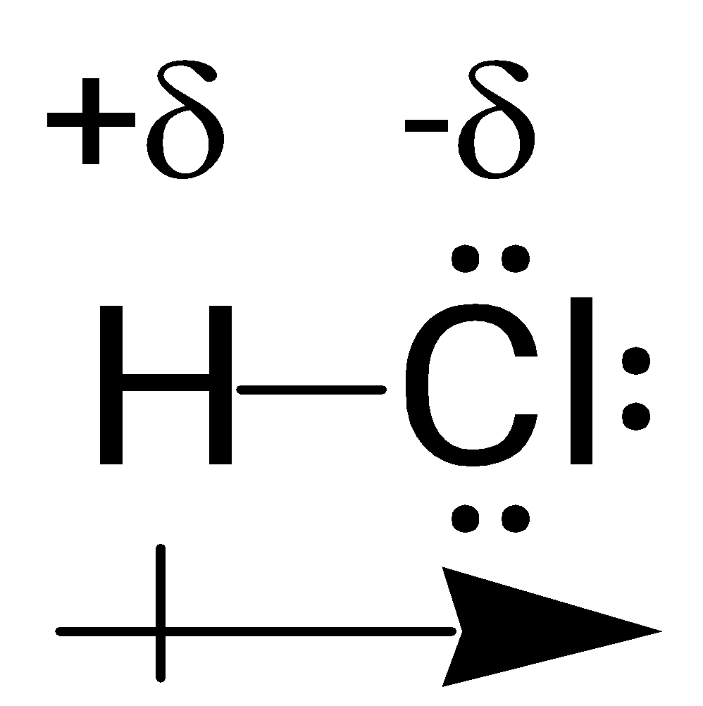
Polar Covalent Bonding
Example: HCl
H = 2.1, Cl = 3.0
Difference is 0.9, so
this is an polar covalent bond!
Cl has a greater electronegativity than H, and therefore, pulls the electrons in the shared bond towards itself.
Cl has slight negative charge (-δ) and H has slight positive charge (+ δ)

Slide 8

Next, we are going to look at Non-Polar Covalent Bonds…
What is non-polar covalent?
This couple is non- polar because they are sharing the drink equally between them.
-Non polar covalent is a covalent bond that has an even distribution of charge due to an equal sharing of bonding electrons.
Examples:
All diatomic molecules (ie: Cl₂, H₂)

Slide 9
Significance of Molecular Polarity
Why is polarity of the whole molecule so important?
Many physical properties of substances (ie: state at SATP, melting and boiling points, solubility) are affected by the polarity of their molecules, not just their intramolecular bonds

Slide 10
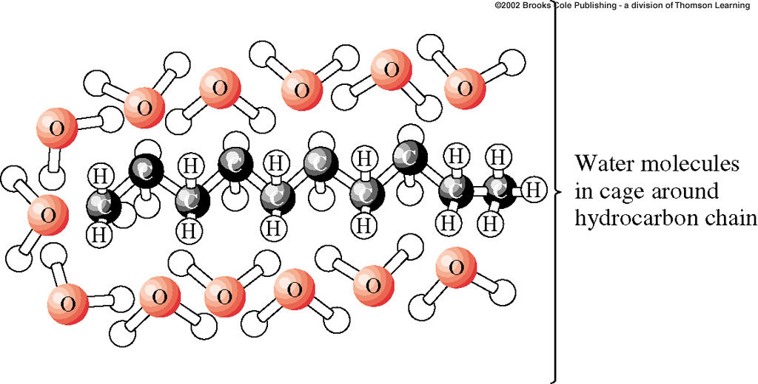
Bond Polarity
This is why oil and water will not mix! Oil is nonpolar, and water is polar.
The two will repel each other, and so you can not dissolve one in the other

Slide 11
STOP HERE DAY 1

Slide 12
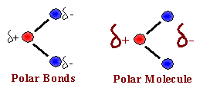
Predicting the Polarity of Molecules
If a molecule contains only nonpolar bonds than the molecule is nonpolar.
In a molecule that has only one bond, and that bond is polar, the molecule is polar.
If a molecule contains more than one polar bond we have to also look at the shape of the molecule.

Slide 13
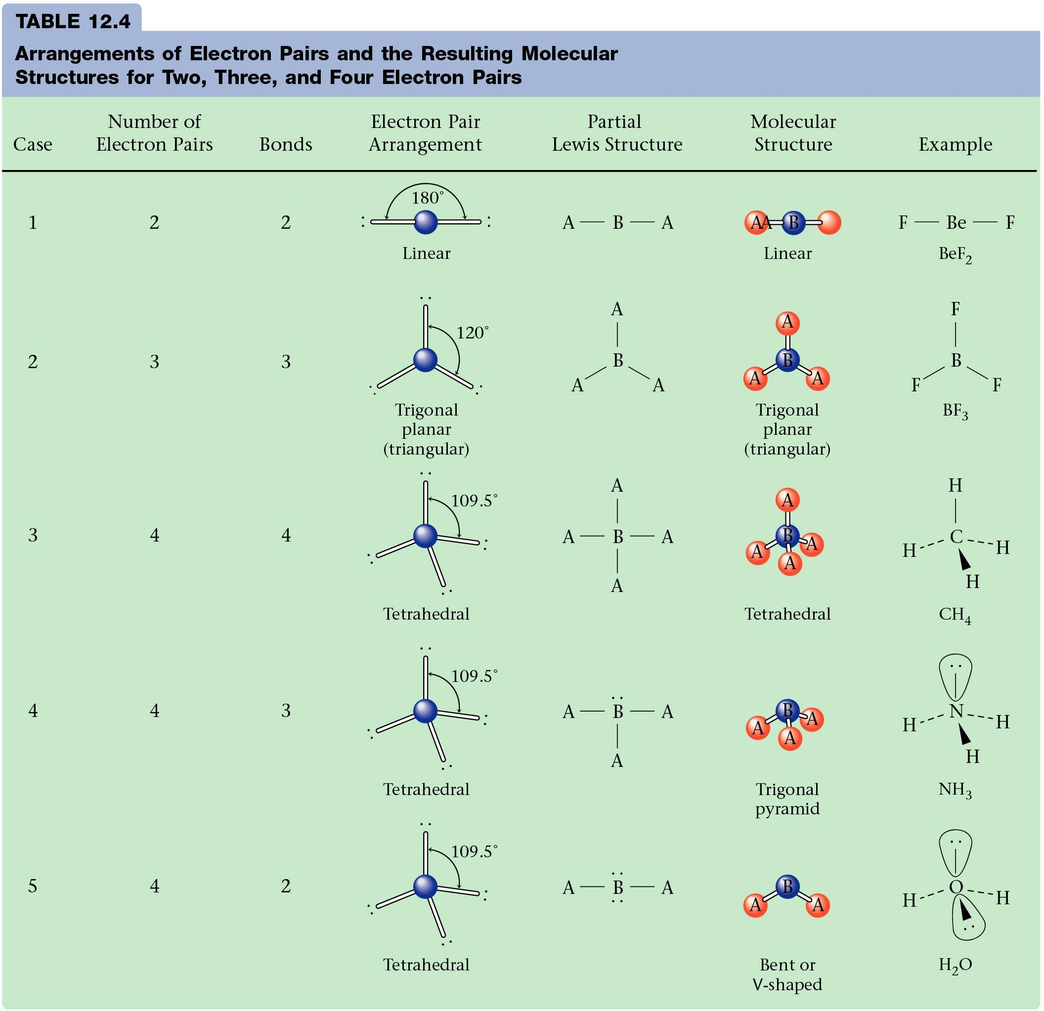

Slide 14
Predicting the Polarity of Molecules
If a molecule contains more than one polar bond
look at the shape:
Shape must be symmetrical i.e. tetrahedral, linear, trigonal planar
All atoms bonded to the central atom must be the same.
Both of these statements must be TRUE for the molecule to be nonpolar.

Slide 15

(+δ)
3.0
4.0
4.0
Shape must be symmetrical 🡪pyramidal is NOT symmetrical
All atoms bonded to the central atom must be the same 🡪 all Fluorines
Both of these statements are not true for the molecule 🡪 polar molecule.
4.0

Slide 16
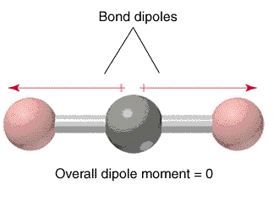
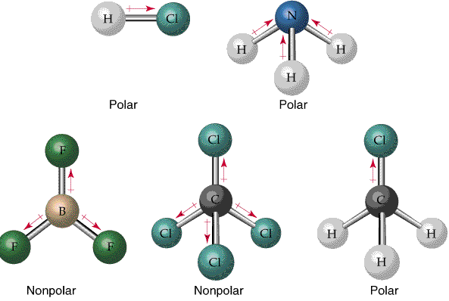
Shape must be symmetrical 🡪linear,
All atoms bonded to the central atom must be the same 🡪 all Oxygen (pink)
Both of these statements are true for the molecule 🡪 nonpolar molecule.

Slide 17
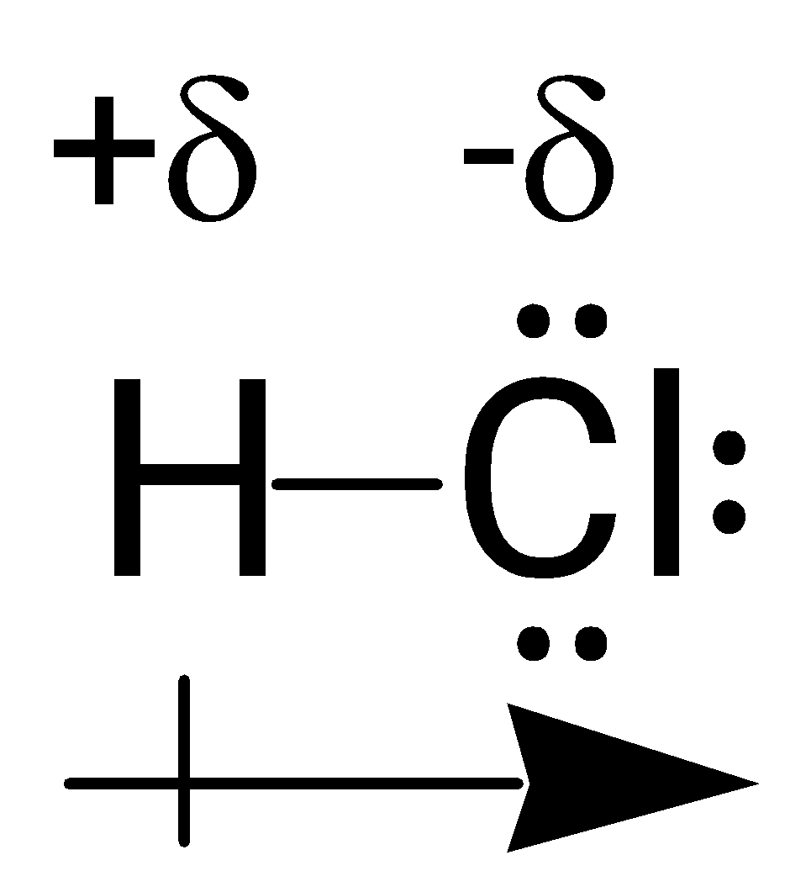
Practice: Determining Molecular Polarity
Carbon tetrachloride? _____________
Hydrogen chloride? _____________
+δ
H
-δ
H
C
H
+δ
+δ
H
+δ
Oxygen? _____________
Carbon dioxide? _____________
Nitrogen trihydride? _____________
O
H
N
H
O
O
C
O
H

